Slide 1
Backward Divided Difference
by
Dr. Md. Rajibul Islam
CSE, UAP

Slide 2
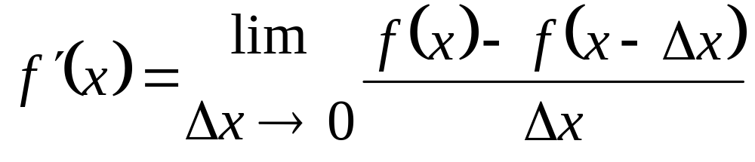

Definition
.
Slope at
y
f(x)
x

Slide 3
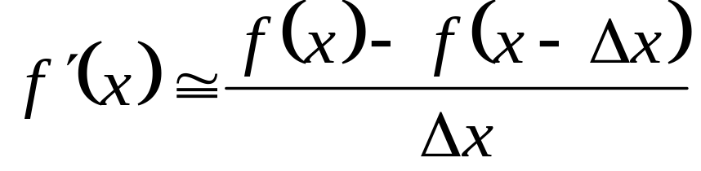



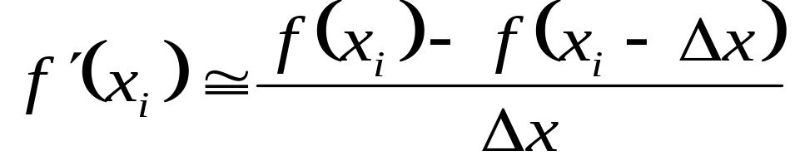
Backward Divided Difference

Slide 4
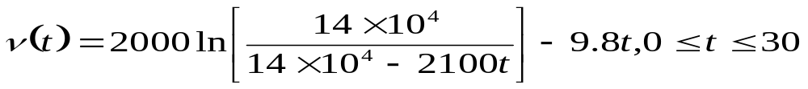




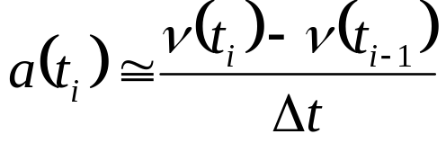
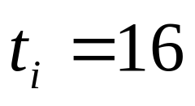
Example
Example:
The velocity of a rocket is given by
where
given in m/s and
is given in seconds. Use backward difference approximation
Of the first derivative of
to calculate the acceleration at
Use a step size of
Solution:

Slide 5



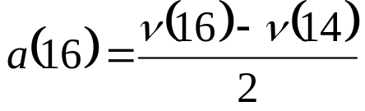
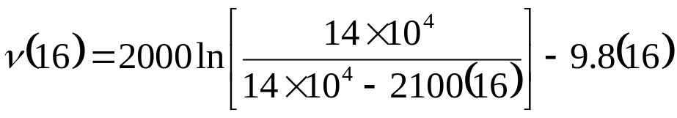



Example (contd.)

Slide 6
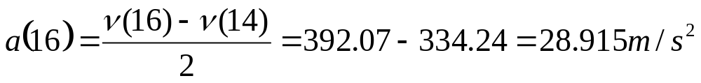

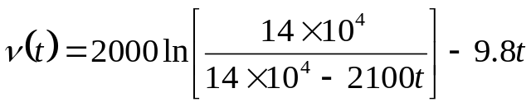
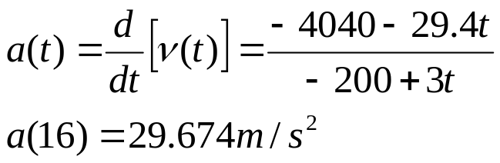
Example (contd.)
Hence
The exact value of
can be calculated by differentiating
as

Slide 7
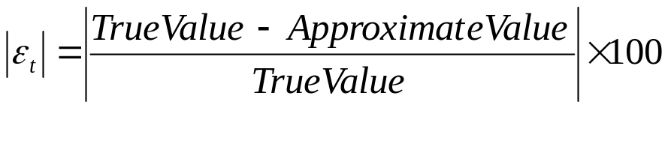
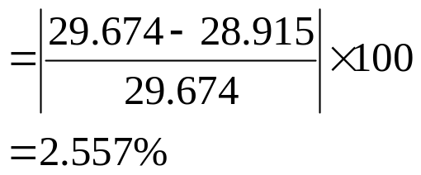
Example (contd.)
The absolute relative true error is

Slide 8
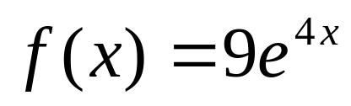

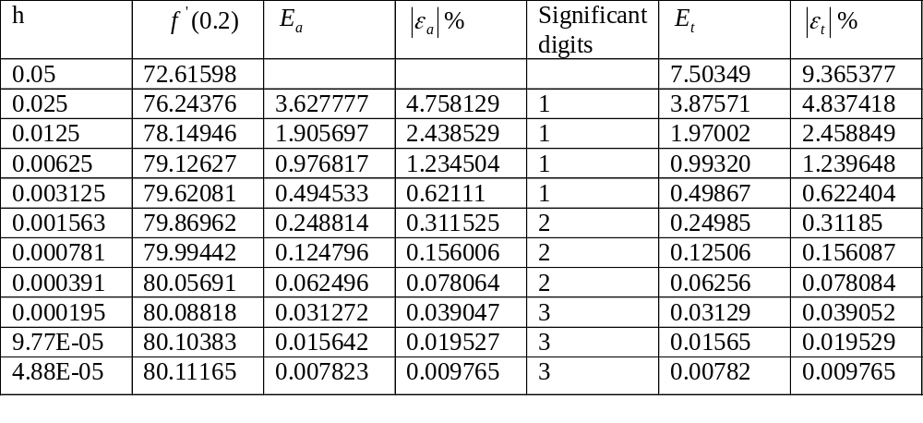
Effect Of Step Size
Value of
Using backward Divided difference method.

Slide 9
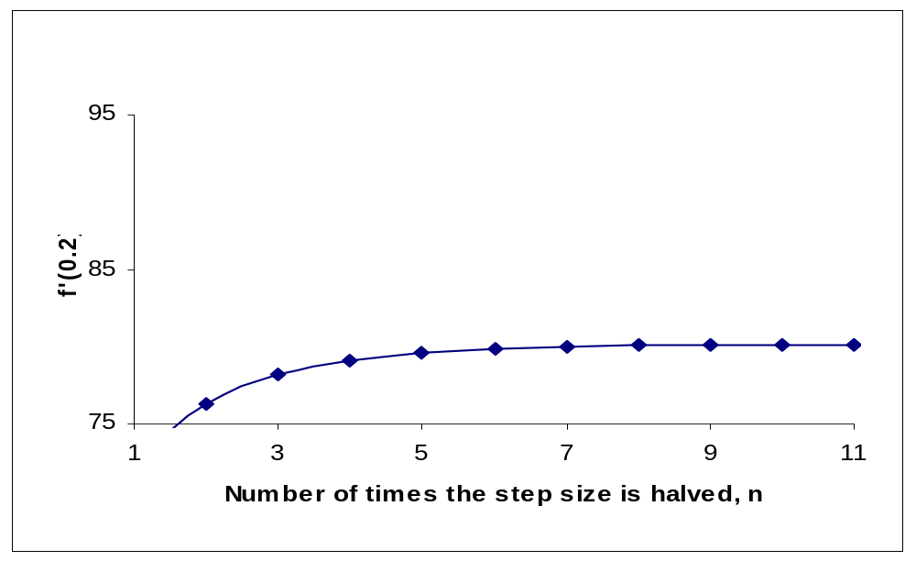
Effect of Step Size in Backward Divided Difference Method
Initial step size=0.05

Slide 10
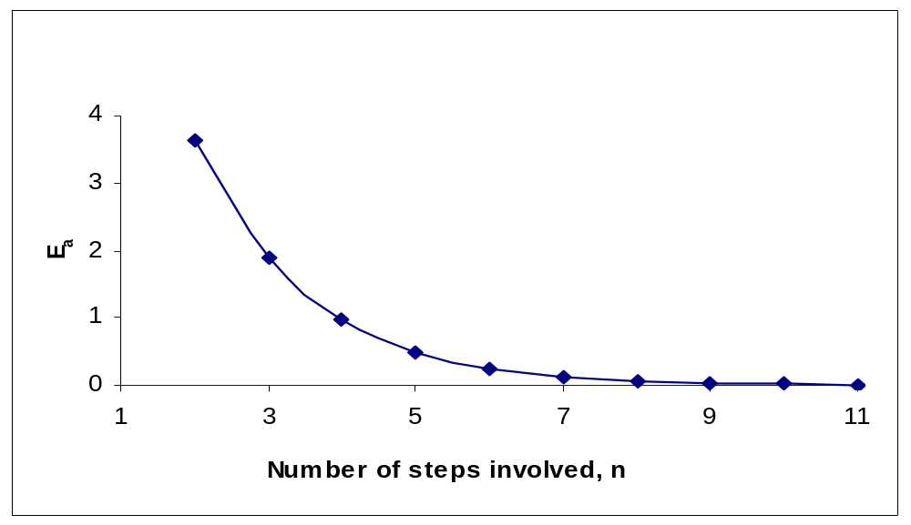
Effect of Step Size on Approximate Error
Initial step size=0.05

Slide 11
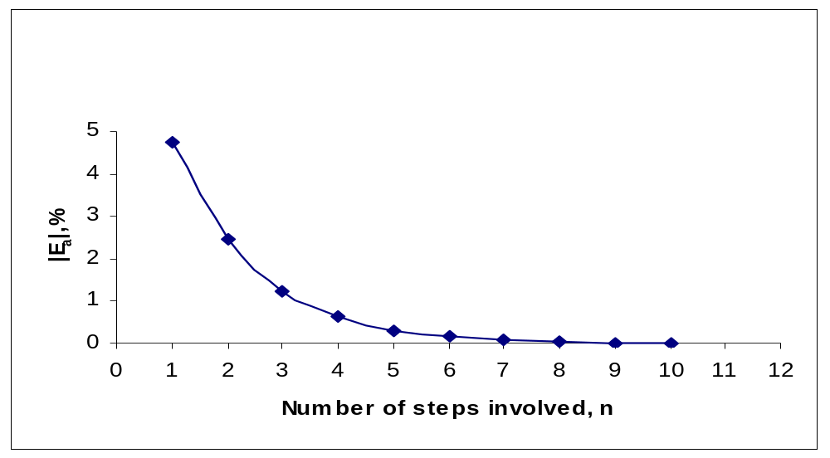
Effect of Step Size on Absolute Relative Approximate Error
Initial step size=0.05

Slide 12
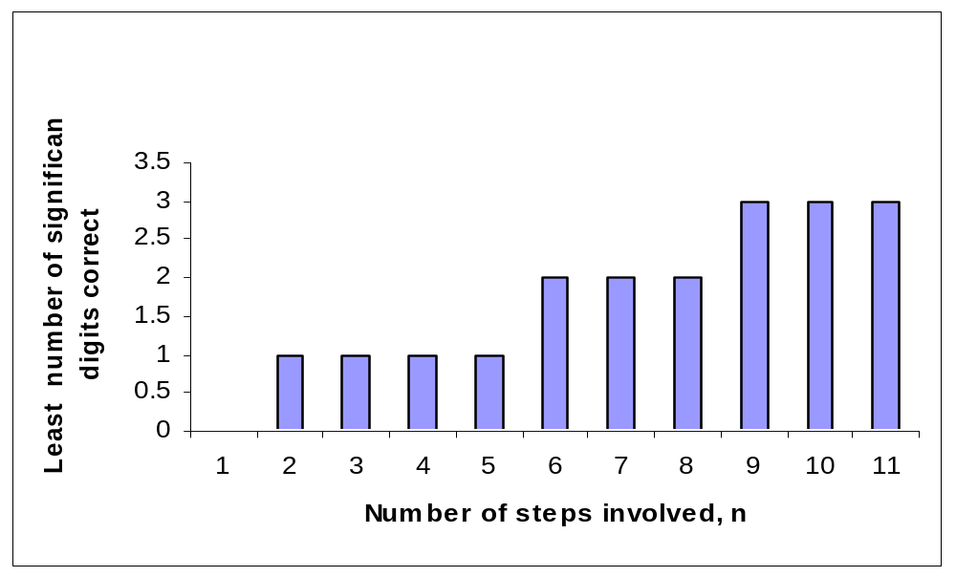
Effect of Step Size on Least Number of Significant Digits Correct
Initial step size=0.05

Slide 13
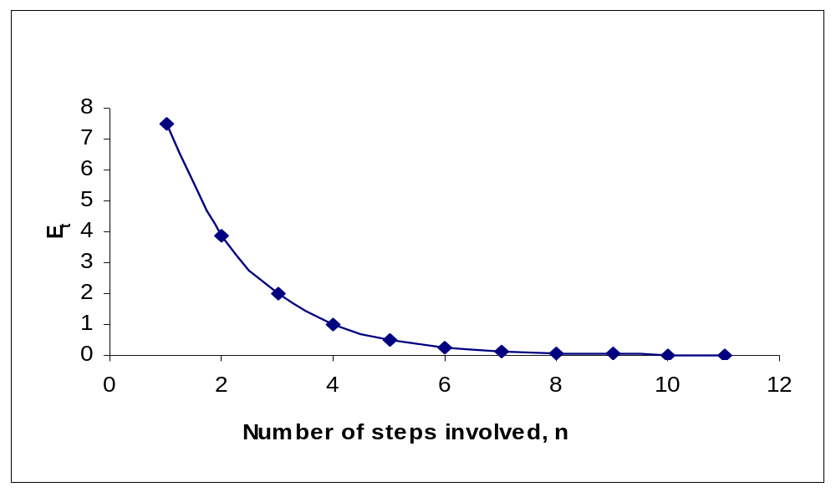
Effect of Step Size on True Error
Initial step size=0.05

Slide 14
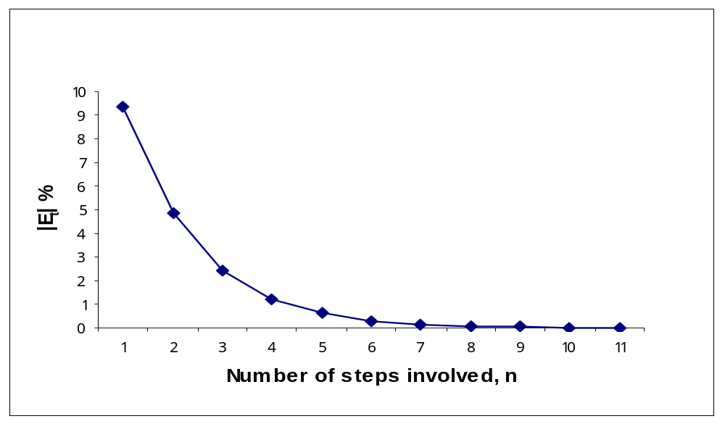
Effect of Step Size on Absolute Relative True Error
Initial step size=0.05

Slide 15
THE END

